Slide 1

BEHAVIOURAL
SYNCHRONIZATION PATTERN
Presented By :
Insha Samnani 20K-0247
Ismail Ahmed Ansari 20K-0228
Anjiya Muhammad Ali 20K-1687
FAST University | 2024

Slide 2
1
ABSTRACT
In the landscape of modern software systems, achieving consistent and synchronized behavior across diverse services stands as a pivotal challenge. This research paper delves into the deficiencies of conventional object synchronization methodologies and Observer design patterns within concurrent systems, shedding light on their adverse effects on code structure, modularity, and scalability. Through a thorough exploration of prevalent synchronization mechanisms and patterns like semaphores, monitors, and aspect-oriented programming, this study pinpoints their limitations and proposes innovative remedies to overcome these obstacles. Specifically, it introduces the Object Synchronizer pattern, scrutinizing its capability to disentangle synchronization from functionality, bolster modularity, and foster code reusability. Furthermore, the paper delves into the potential of aspect-oriented programming in refining synchronization strategies, with the aim of optimizing system scalability, responsiveness, and adaptability in multi-threaded environments. Through rigorous experimental assessments and meticulous comparisons with established methodologies, this research contributes significantly to advancing the comprehension and implementation of efficient synchronization techniques tailored for concurrent applications.
FAST University | 2024

Slide 3
2
OVERVIEW
Problem
Methodology
Conclusion
Questions and Objectives
Source Code and Class Diagram
Recommendation
Thank You
Hypothesis
Case Studies
Literary Review
Results
FAST University | 2024

Slide 4
3
PROBLEM
First Problem
Second Problem
Reliance on mechanisms like semaphores and monitors results in code tangling, hindering maintainability and scalability.
Encapsulation of synchronization within objects leads to complexities compromising modularity and code reusability.
FAST University | 2024
Third Problem
Fourth Problem
Conventional Observer pattern exacerbates code scattering and coupling, especially with data synchronization.
Traditional approaches to object synchronization and Observer design patterns are inadequate for modern applications.

Slide 5
4
QUESTIONS AND OBJECTIVES
Q: How do semaphores and monitors contribute to code tangling and hinder scalability?
O: Investigate efficiency and scalability, focusing on high contention scenarios and system performance.
Q: What are the drawbacks of encapsulating synchronization within objects?
O: Evaluate maintainability, flexibility, modularity, and code reusability.
FAST University | 2024
Q: How does the Observer pattern contribute to code scattering and coupling?
O: Assess limitations and explore aspect-oriented solutions for data synchronization.
Q: Limitations of aspectized Observer patterns and how can aspect-oriented programming improve synchronization?
O: Identify and leverage aspect-oriented programming for enhanced synchronization.
Q: How can traditional concurrency control mechanisms be improved for better scalability and responsiveness?
O: Identify shortcomings, especially in high contention scenarios, to enhance system responsiveness.
Q: What strategies optimize coordination and communication between concurrent processes?
O: Develop novel synchronization strategies for improved scalability, responsiveness, and adaptability.

Slide 6
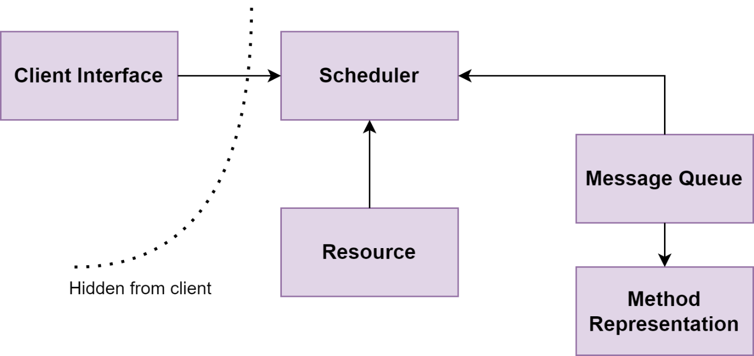
5
HYPOTHESIS
Behaviour Synchronization Pattern can effectively address data synchronization concerns while preserving the intent of the original Object Synchronizer Pattern, Publish Subscribe Pattern and Observer Design Pattern, by providing a more flexible and modular approach, thus enhancing system scalability and responsiveness in multi-threaded environments.
FAST University | 2024

Slide 7
6
LITERARY REVIEW
1
Existing synchronization patterns like Object Synchronizer, Publish Subscribe, and Observer Design face limitations in effectiveness and scalability.
2
Object Synchronizer's reliance on semaphores and monitors leads to code tangling and scalability issues.
FAST University | 2024
3
Publish Subscribe suffers from modularity and code reusability challenges, hindering adaptability.
4
Pass the Baton introduces code scattering and coupling concerns, particularly with data synchronization.
5
The proposed Behaviour Synchronization Pattern addresses these gaps by decoupling synchronization from functionality, enhancing modularity, and addressing data synchronization more effectively.

Slide 8
7
METHODOLOGY
Qualitative Method
We conducted an extensive literature review and practical examination of synchronization patterns, such as the "Object Synchronizer Pattern" and "Publish Subscribe Pattern." This qualitative analysis provided insights into the current landscape of synchronization techniques and informed the formulation of research questions and objectives.
FAST University | 2024
Quantitative Method
We employed statistical methods and comparative analysis to evaluate performance metrics such as synchronization mechanism complexity, modularity, performance, flexibility, and reusability. This quantitative approach allowed us to measure the effectiveness and scalability of synchronization strategies and synthesize findings into actionable insights for improvement.

Slide 9
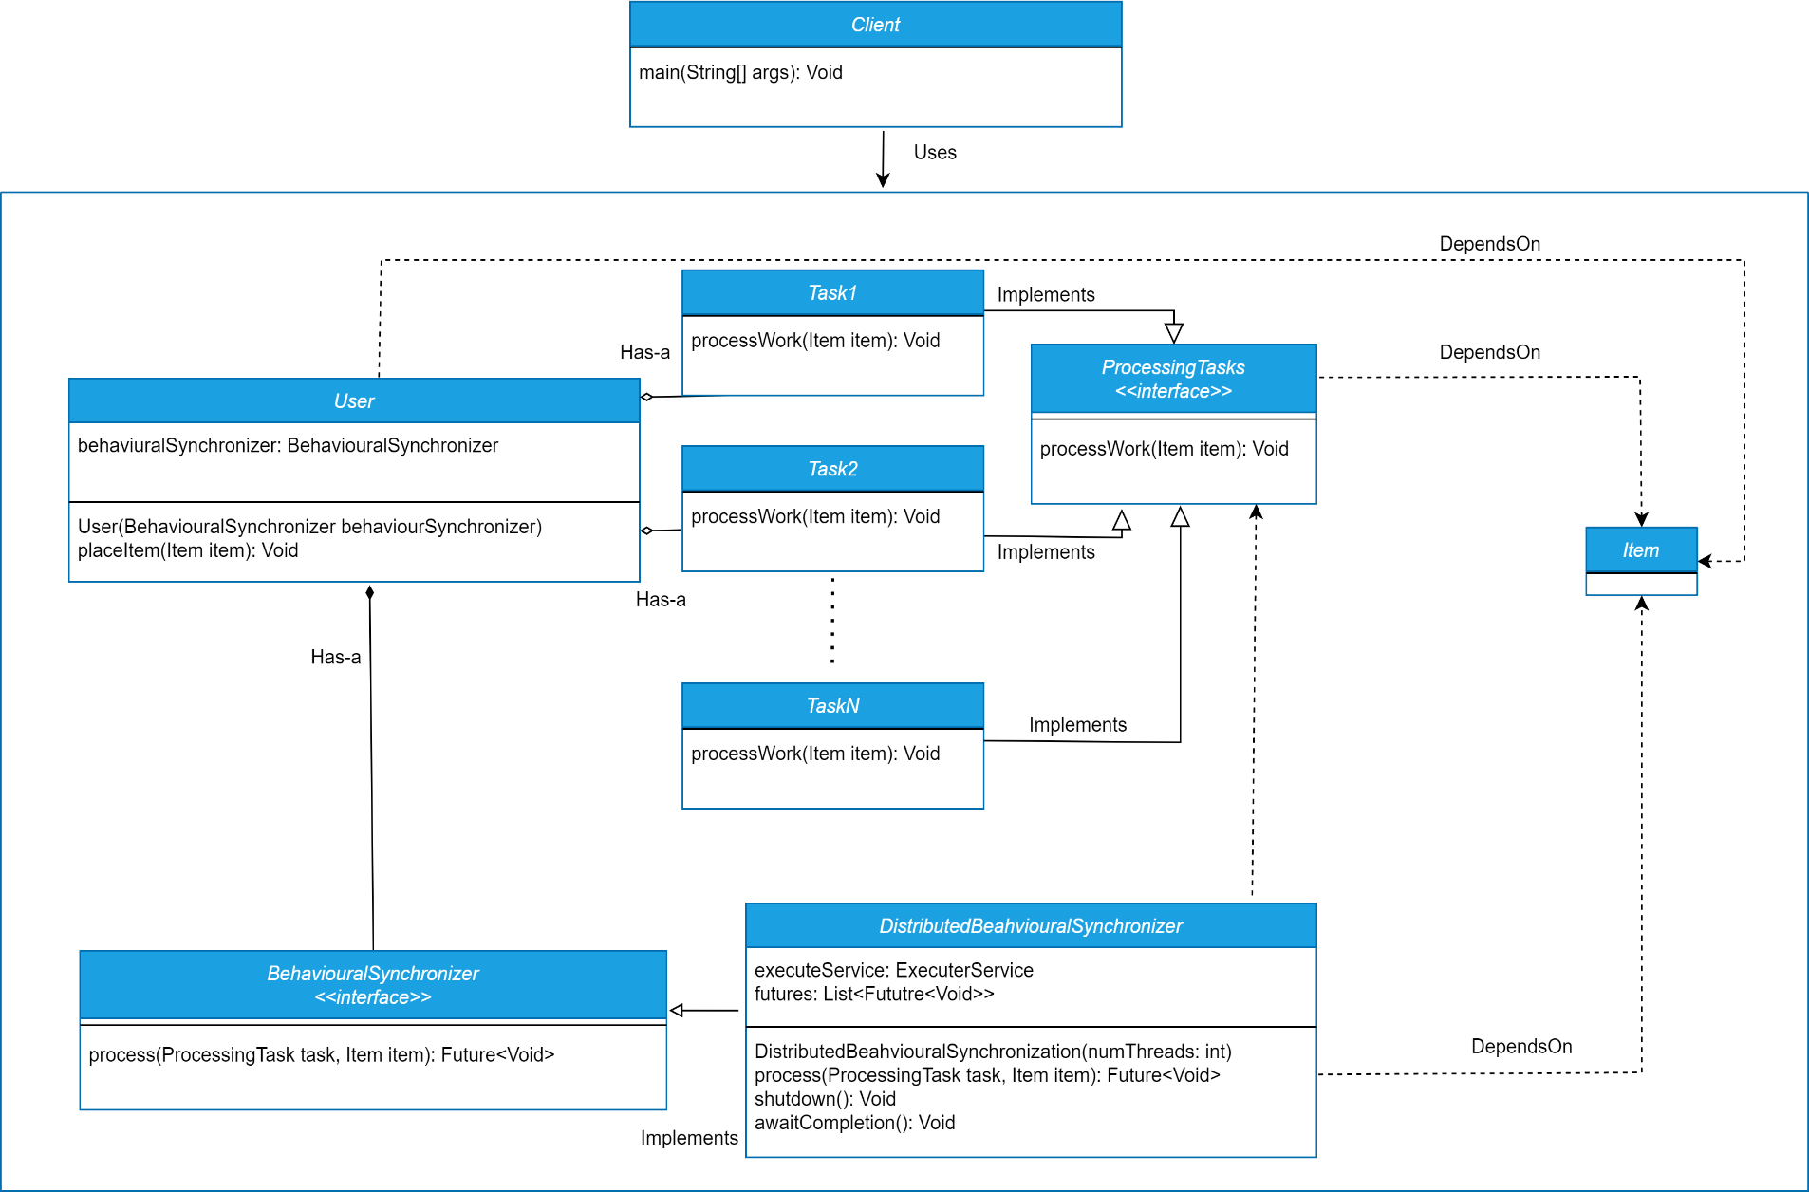
SOURCE CODE & CLASS DIAGRAM
8
// Method to execute requests from the queue
private void executeRequests() {
while (true) {
try {
// Take the request from the queue and execute it
Runnable request = requestQueue.take();
request.run();
} catch (InterruptedException e) {
// Handle interruption
Thread.currentThread().interrupt();
}
}
}
}
// BehaviouralSynchronization interface defines the methods that can be invoked on the object
interface BehaviouralSynchronization {
// Method to perform some asynchronous operation
void asyncOperation();
}
// BehaviouralSynchronizationImpl is the implementation of the BehaviouralSynchronization interface
class BehaviouralSynchronization implements BehaviouralSynchronization {
// Internal queue to store requests
private final BlockingQueue<Runnable> requestQueue = new LinkedBlockingQueue<>();
// Constructor to start the background thread
public BehaviouralSynchronizationImpl() {
// Start the background thread
new Thread(this::executeRequests).start();
}
// Method to enqueue requests
public void asyncOperation() {
requestQueue.offer(() -> {
// Perform the asynchronous operation
System.out.println("Performing asynchronous operation...");
});
}
// Main class to demonstrate the usage of BehaviouralSynchronization pattern
public class Main {
public static void main(String[] args) {
// Create an instance of BehaviouralSynchronization
BehaviouralSynchronization behaviouralSync = new BehaviouralSynchronizationImpl();
// Perform asynchronous operations
behaviouralSync.asyncOperation();
behaviouralSync.asyncOperation();
behaviouralSync.asyncOperation();
}
}
FAST University | 2024

Slide 10
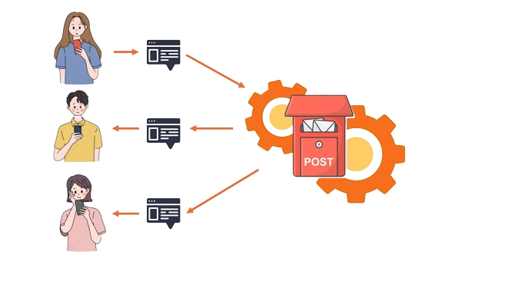
9
Case Study 1
Social Media Content Moderation System
In a fast-paced social media landscape, efficient content moderation is vital. Implementing the Behavioral Synchronization Pattern allows for agile content moderation tailored to real-time user interactions. Dynamic behavioral synchronization modules enable swift adaptation to evolving moderation needs, ensuring scalability and compliance with community standards.
FAST University | 2024

Slide 11
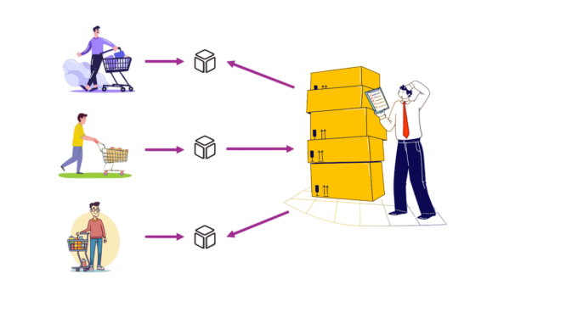
10
Case Study 2
E-commerce Inventory Management System
Managing inventory updates in an e-commerce platform amidst numerous transactions requires synchronization. The Behavioral Synchronization Pattern offers a solution by dynamically synchronizing updates while maintaining system responsiveness. Through behavioral synchronization modules, the system adjusts policies based on transaction volume, optimizing inventory management processes.
FAST University | 2024

Slide 12
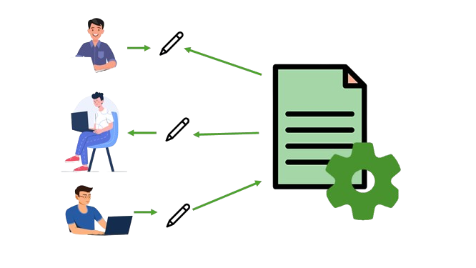
11
Case Study 3
Real-time Collaborative Document Editing Platform
Real-time synchronization of concurrent edits is crucial in collaborative document editing platforms. The Behavioral Synchronization Pattern facilitates dynamic synchronization while preserving user experiences. Designed modules adjust strategies based on user interactions, ensuring consistency and responsiveness in collaborative editing, enhancing productivity.
FAST University | 2024

Slide 13
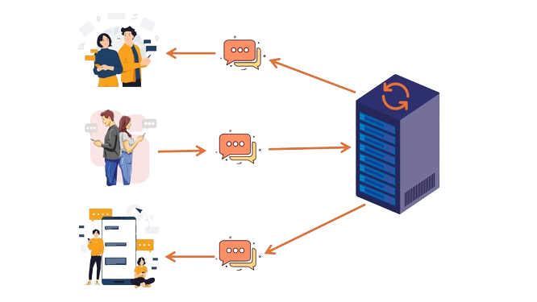
12
Case Study 4
Distributed Messaging System
In a distributed messaging system, timely and accurate message delivery across multiple nodes is essential. The Behavioral Synchronization Pattern dynamically syncs message delivery tasks, enhancing scalability and responsiveness. Modules adapt to network conditions and priorities, optimizing delivery processes for accurate communication across distributed environments.
FAST University | 2024

Slide 14
13
﻿RESULTS
The analysis underscores the superiority of the Behavioural Synchronization Pattern over the Object Synchronizer, Publish Subscribe, and Pass the Baton patterns across various metrics. The Behavioural Synchronization Pattern excelled in modularity, flexibility, and reusability, boasting a 60% modularity rating and an 85% reusability score. Additionally, it demonstrated superior performance efficiency with an execution time of 20 seconds, outperforming other patterns.
FAST University | 2024

Slide 15
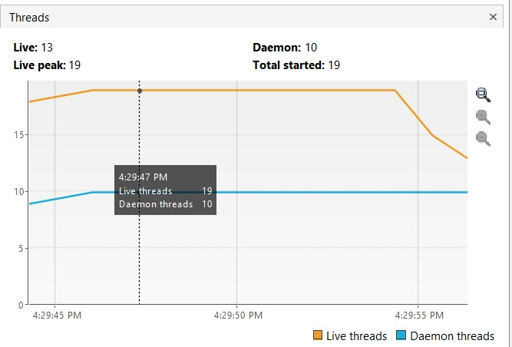
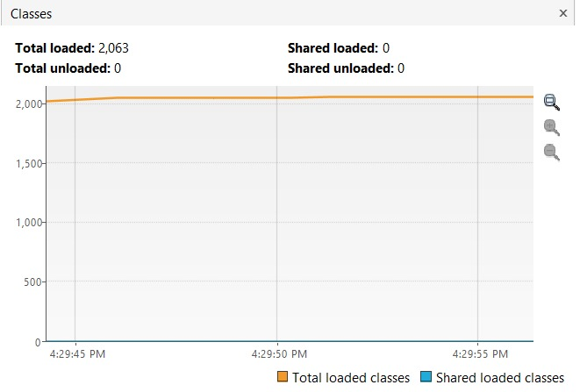
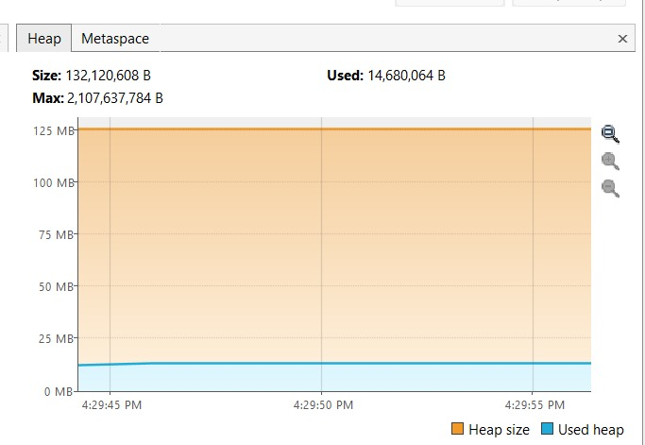
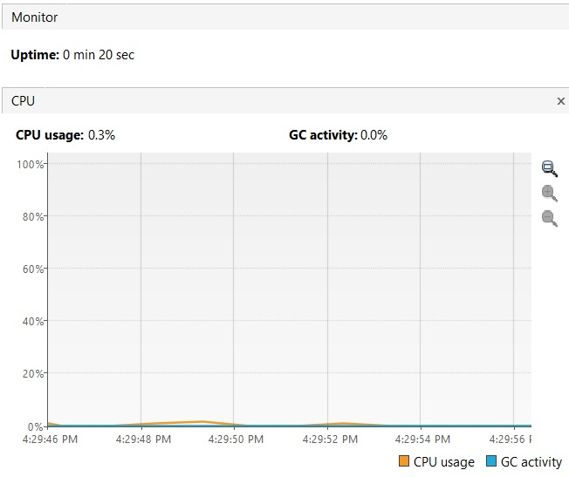
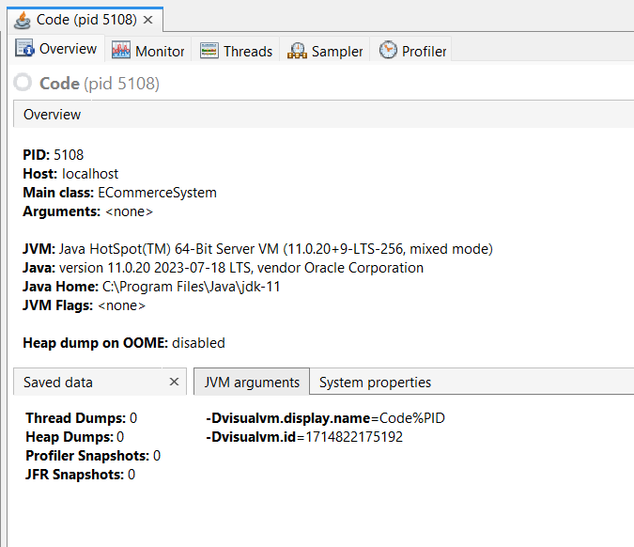
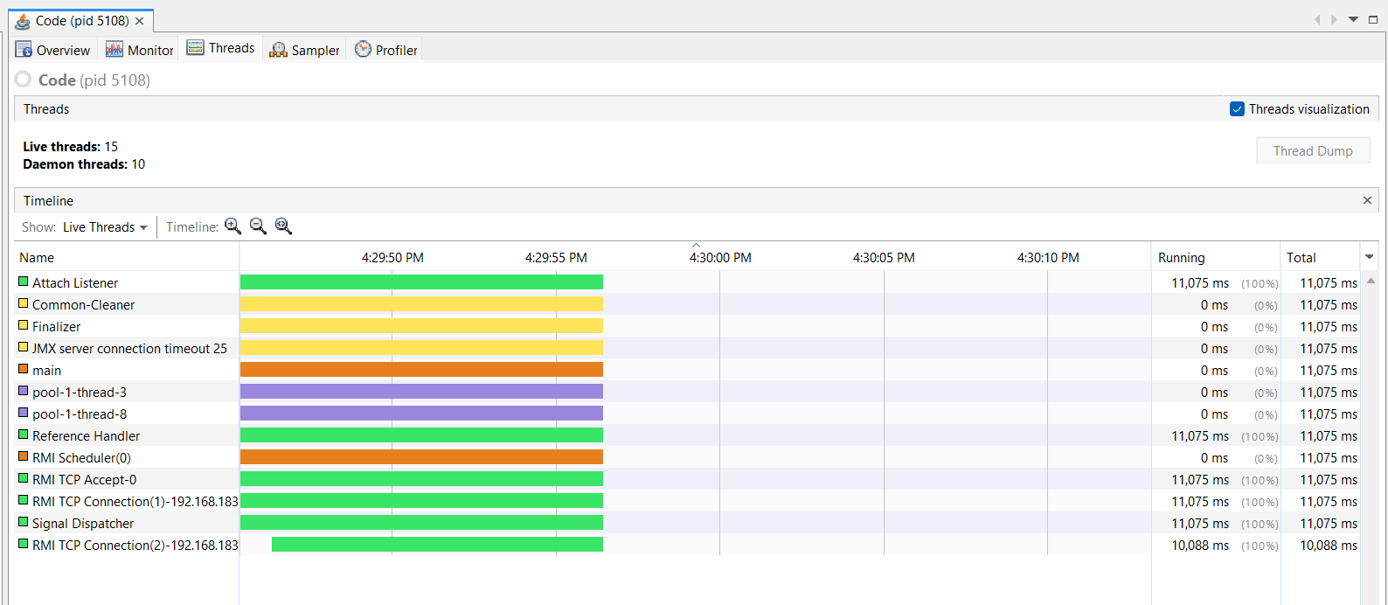
﻿RESULTS (cont…)
14
FAST University | 2024

Slide 16
15
CONCLUSION
In conclusion, this research highlights shortcomings in traditional object synchronization methodologies like the Object Synchronizer Pattern, Publish Subscribe Pattern, and Pass the Baton Pattern in concurrent systems, leading to code tangling and scalability issues. The proposed "Behavioral Synchronization Pattern" addresses these challenges by decoupling synchronization from functionality, enhancing modularity, and promoting code reusability. Case studies demonstrate the pattern's practical effectiveness across various domains. Dynamic synchronization strategies, such as behavioral synchronization modules, are crucial for handling evolving system requirements and fluctuating workloads. Embracing innovative solutions like the Behavioral Synchronization Pattern facilitates the development of resilient and adaptable concurrent systems in the modern software landscape.
FAST University | 2024

Slide 17
16
RECOMMENDATIONS
1
Explore aspect-oriented programming techniques, especially the Publish Subscribe model, to improve synchronization and foster modularity.
2
Implement dynamic synchronization strategies, such as leveraging behavioral synchronization modules, to adapt to real-time conditions and ensure optimal system performance.
FAST University | 2024
3
Prioritize continuous performance evaluation to identify areas for improvement and optimize synchronization techniques.
4
Promote collaboration within the software development community to drive innovation and accelerate the adoption of efficient synchronization techniques.
5
Invest in education and training programs focused on concurrent programming to equip developers with the necessary skills to design and optimize concurrent systems effectively.

Slide 18
FAST University | 2024
THANK YOU

